Slide 1
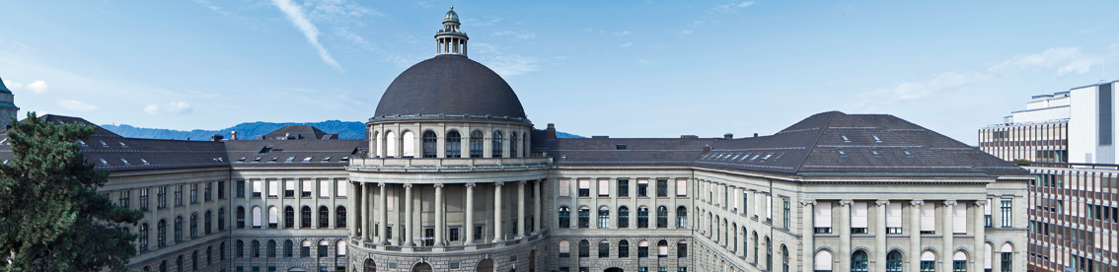
Iterative Semi-Automatic Segmentation using Volumetric Scribbles with a 3D CNN
Master’s Thesis
Hlynur Jökull Skulason
Supervisors: Gustav Bredell, Dr. Christine Tanner & Prof. Dr. Ender Konukoglu

Slide 2
Index
Motivation
Materials and Methods
Experiments and Results
Discussion
Summary

Slide 3
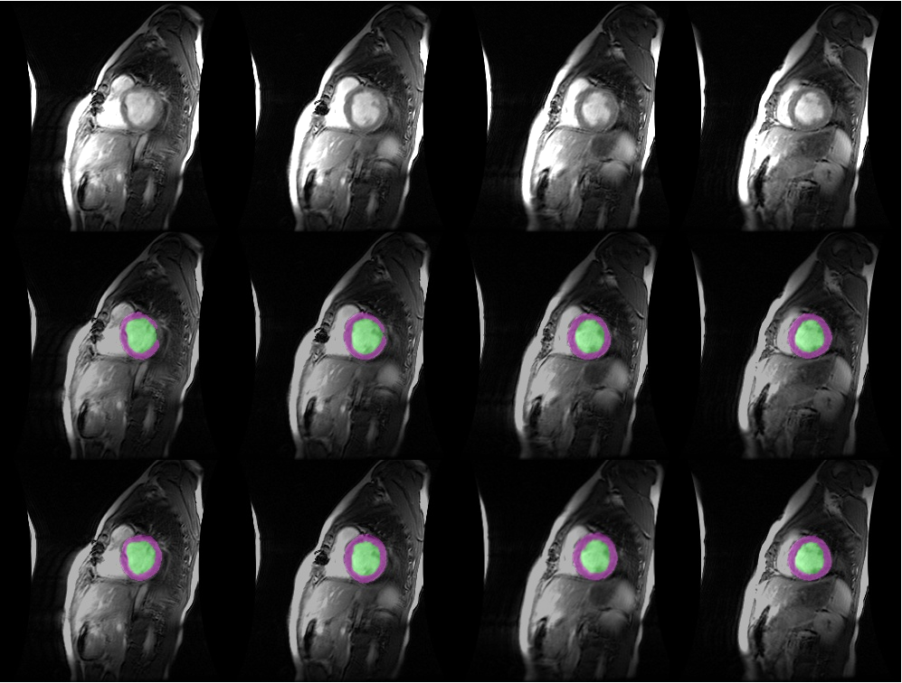
Motivation
Image segmentation is an ever-growing field in medical image analysis.
Manual segmentation.
Fully-automatic segmentation.
Semi-automatic segmentation.
Multiclass segmentation is a difficult task.
2D segmentation is faster, 3D segmentation is more powerful.
[1]
Original slice
2D CNN
3D CNN
Notes:
Image segmentation is one of the biggest and most challenging tasks in medical image analysis to aid human experts in detecting and diagnosing diseases in the human body.
Developing precise and reliable algorithms is critical.
Advancements in machine learning and computer vision have further increased these algorithms' accuracy and dependability.
3D segmentation has proven to be more powerful than 2D segmentation.

Slide 4
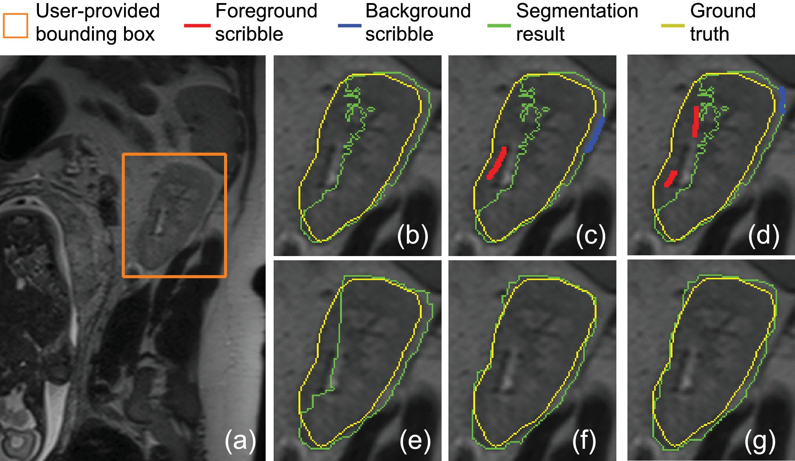
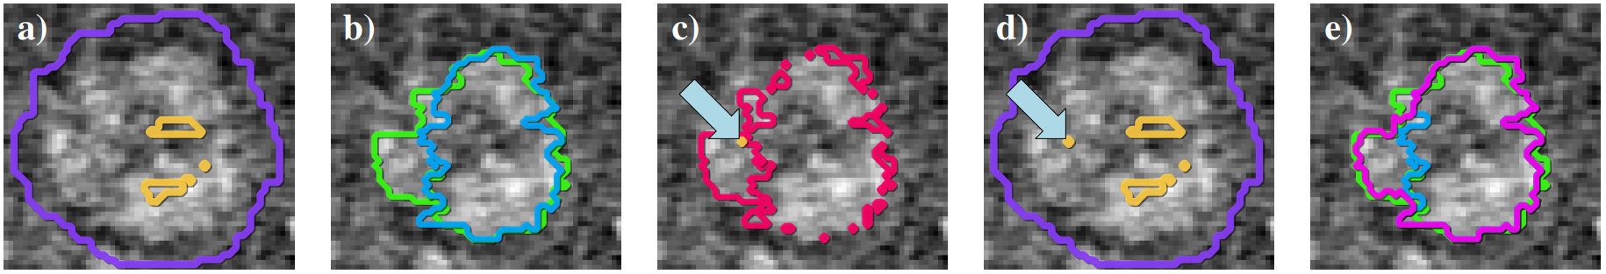
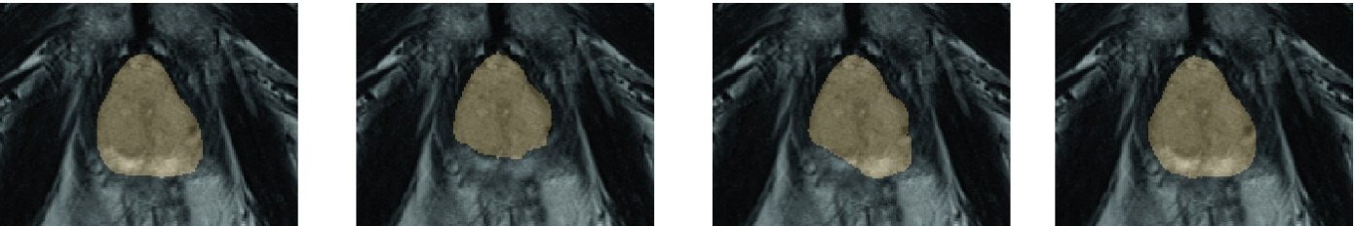
Motivation
[2]
2D Semi-automatic models:
BIFSeg (top image)
UI-Net (middle image)
interCNN (bottom image)
Our goal is to expand the work by Bredell et al. to 3D.
[3]
Ground-truth autoCNN interCNN, 1 iter interCNN, 5 iter
[4]
Notes:
Semi-automatic segm. Fixes the problem with fully-autom. => overfitting / lack of generalization while relying on much less user input than manual segm.
Bredell et al.: developed a framework that surpassed the other two models here for 2D segmentation.
Our goal is to expand the model and scribbles to 3D.

Slide 5
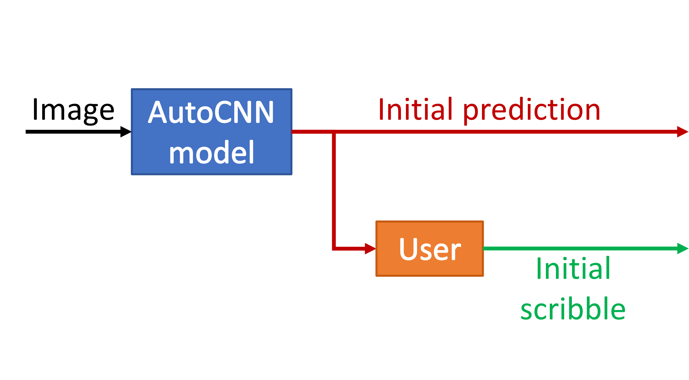
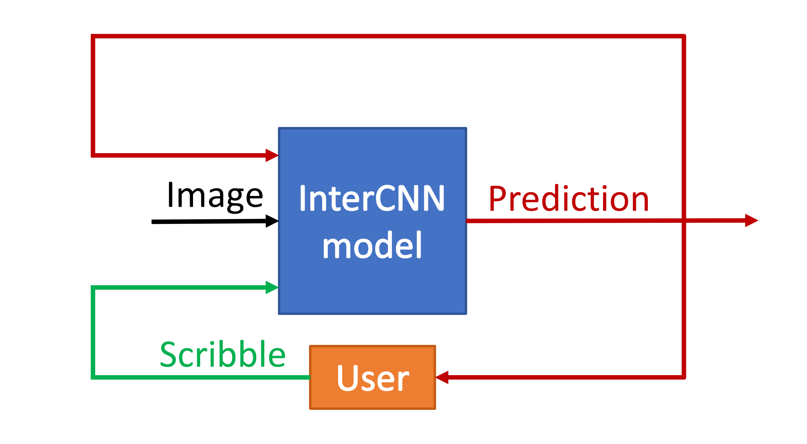
Materials and Methods: Framework
AutoCNN – fully-automatic segmentation model to generate initial predictions.
InterCNN – semi-automatic segmentation model.
Uses the previous predictions and the user input to improve the segmentation.
Notes:
The AutoCNN model creates the initial prediction which the user sees and clicks on the incorrectly predicted pixels which are converted into scribbles.
The image, initial AutoCNN prediction and initial AutoCNN scribbles are fed into the InterCNN model, which creates an updated prediction. The user sees the new prediction and creates new scribbles (if needed) which are fed back into the InterCNN model along with the image and the updated prediction.

Slide 6
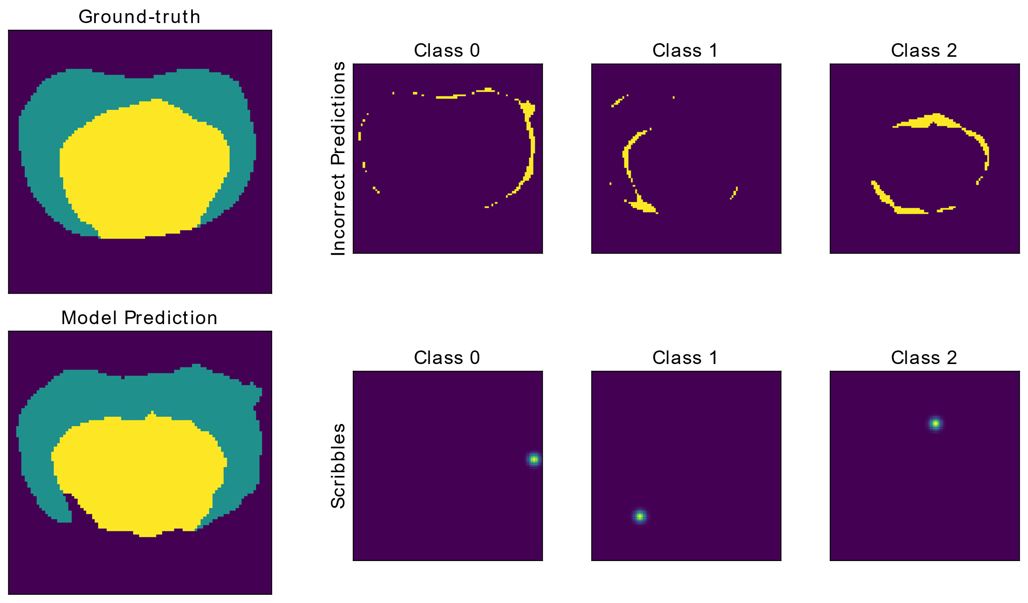
Materials and Methods: Scribble Generation
One round of the robot-user creating scribbles for each class label = iteration.
Notes:
A robot-user inspects the ground-truth and the model’s prediction, finds the incorrectly labeled pixels and clicks on a random one.
The two images on the left show the ground-truth segmentation and the AutoCNN prediction.
The upper row shows the incorrect prediction for each class label and the bottom row shows the scribbles created for each class label.

Slide 7
Materials and Methods: InterCNN with 3D Scribbles
Explore two segmentation tasks:
Binary (all labels except background = 1).
Multiclass (original).
Six different scribble configurations:
Vanilla settings.
Increasing the scribble size by a factor 3.
Placing the scribbles in the largest connected component (LCC)
Placing 5 scribbles for each class.
Placing 10 scribbles for each class.
Placing 15 scribbles for each class.
Notes:
We look at 2D and 3D scribbles. 2D scribbles are placed in each slice, while 3D scribbles can be placed anywhere in the volume.

Slide 8
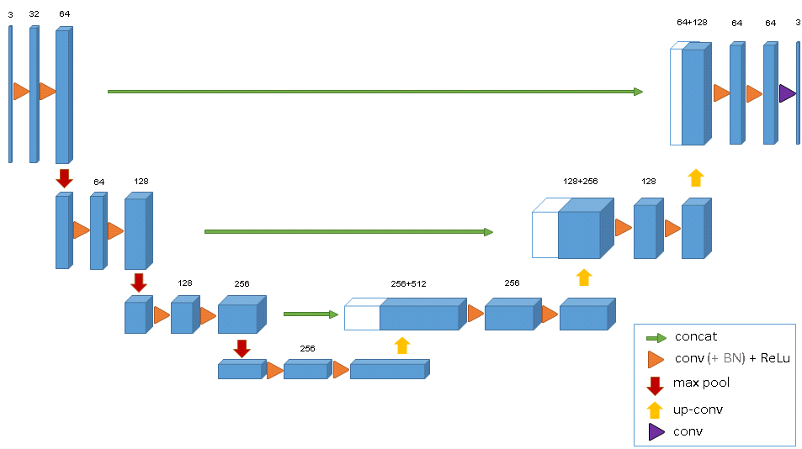
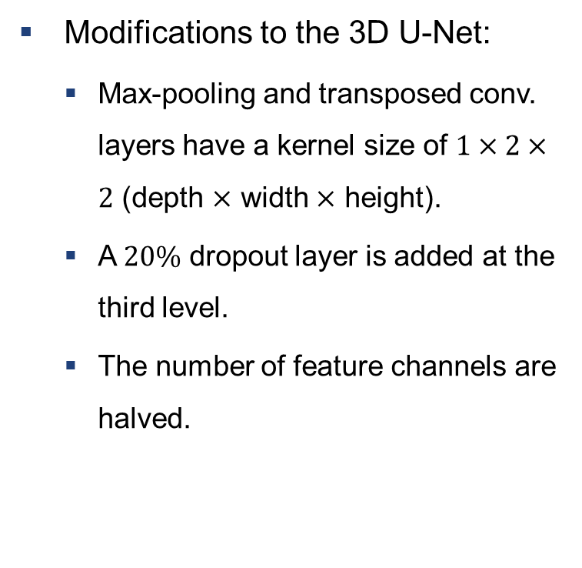
Materials and Methods: Model Architectures
Modifications to the 3D U-Net:
Max-pooling and transposed conv. layers have a kernel size of $1×2×2$ (depth $×$ width $×$ height).
A $20\%$ dropout layer is added at the third level.
The number of feature channels are halved.
[5]
/ 2
/ 2
/ 2
/ 2
/ 2
/ 2
/ 2
/ 2
Dropout
Notes:
The sub-sampled volumes have only 15 slices => would end as a single-slice volume (2D img) at the lowest layer.
Reduce the likelihood of overfitting the data.
Ensure that a sub-sampled volume with full height/width fits into the model (GPU memory)!

Slide 9
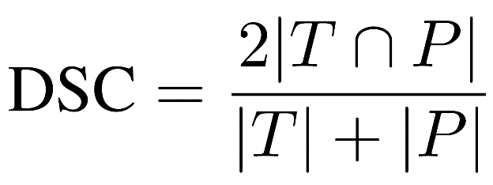
Materials and Methods: Evaluation Metrics
Dice score (DSC), measured in 2D and 3D.
2D DSC is measured slice-wise.
3D DSC is measured volume-wise.
Hausdorff distance, HD and HD95.
HD95 is the 95th percentile of HD.
Notes:
2D DSC: every slice gets a Dice score, then they’re averaged.
3D DSC: measure the predicted volume’s accuracy.
2D DSC may be boosted for specific slices that don’t include a specific label in the ground-truth or the prediction => DSC=1.0
WE FOCUSED ON IMPROVING THE DSC

Slide 10
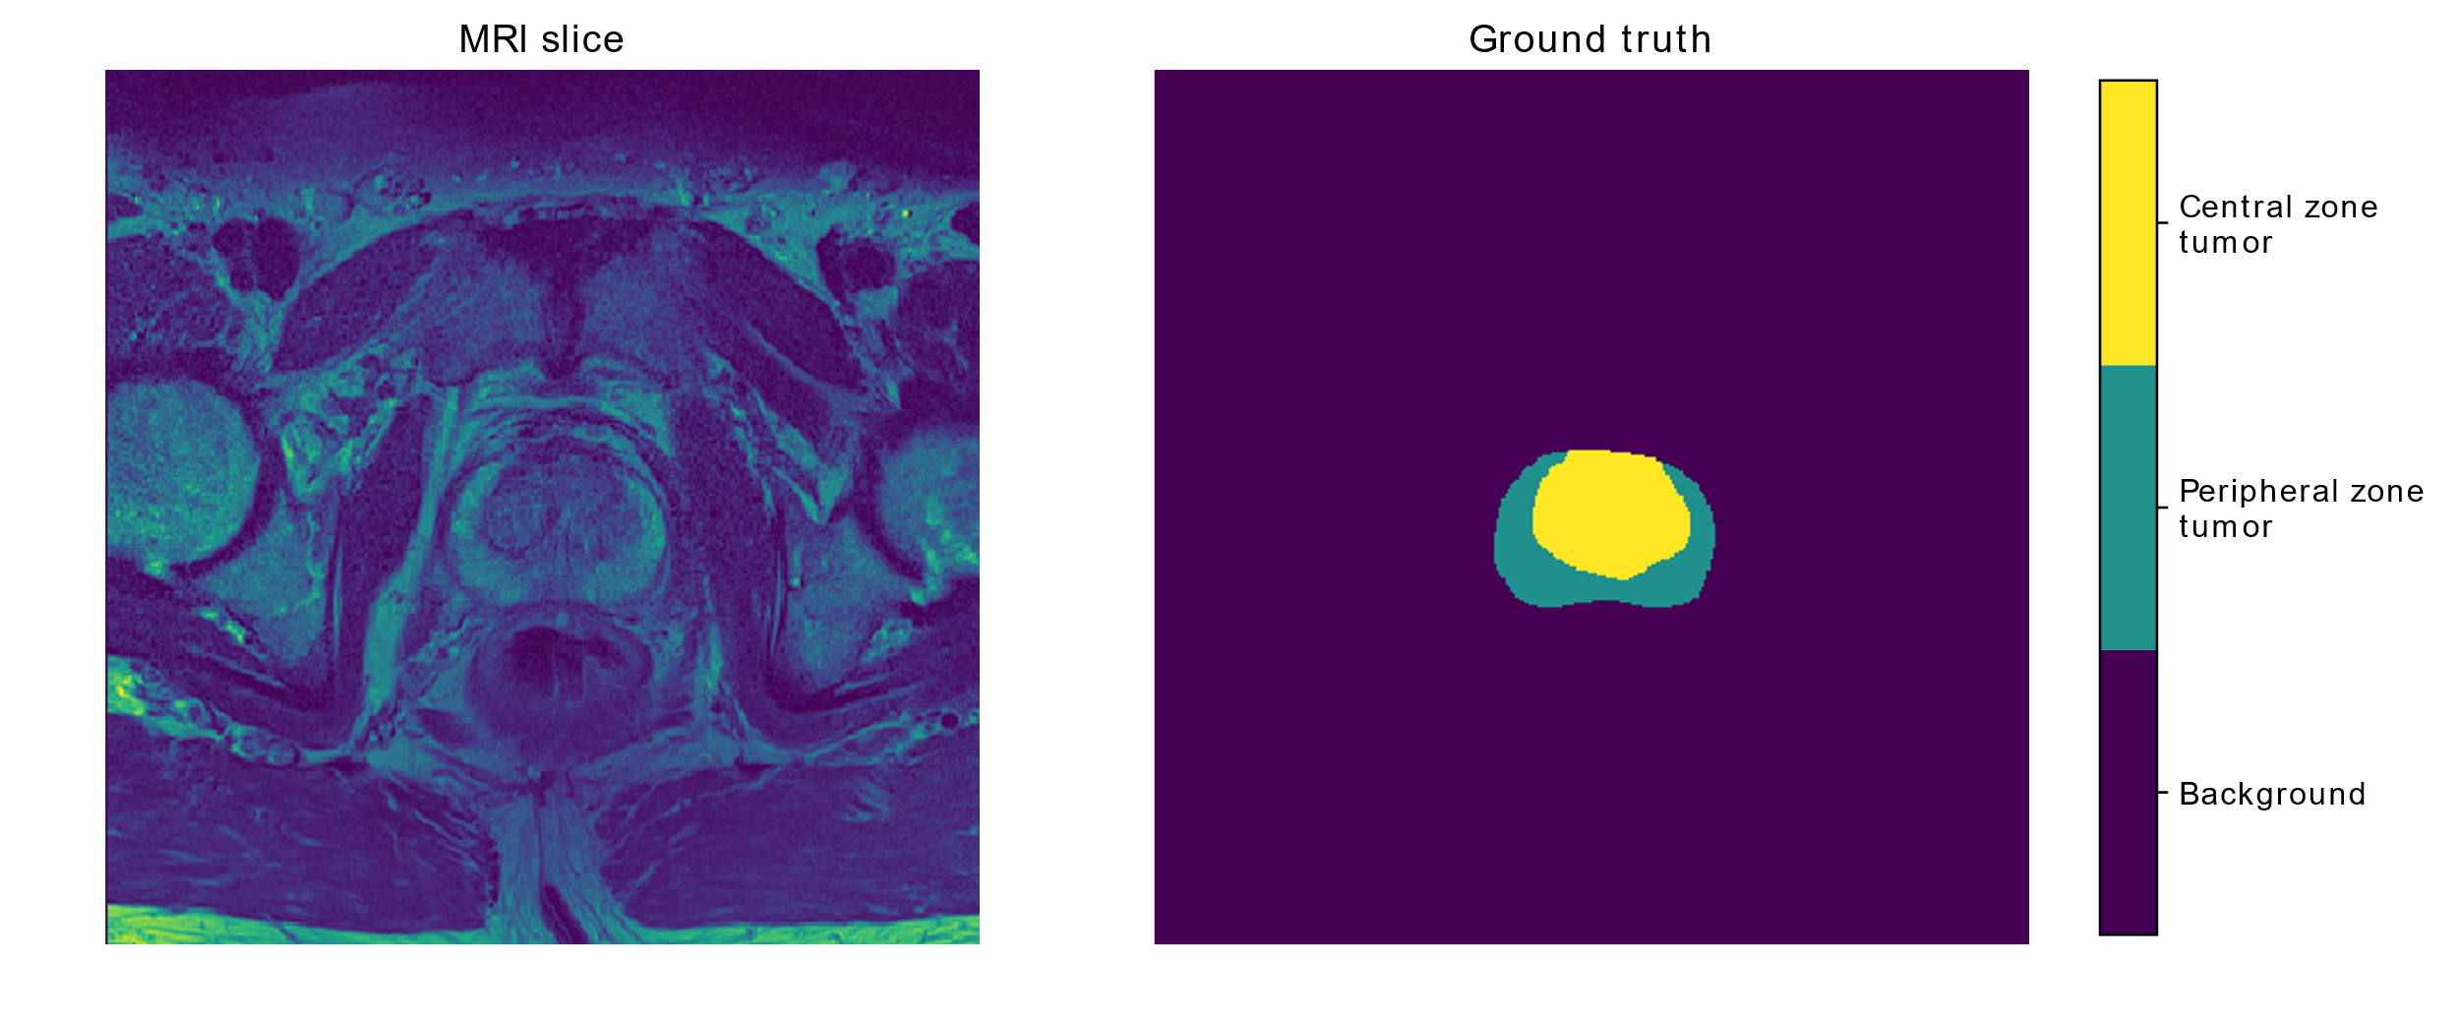
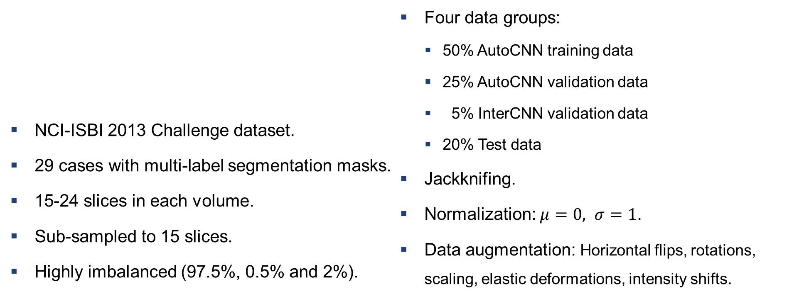
Materials and Methods: Training Procedure
NCI-ISBI 2013 Challenge dataset.
29 cases with multi-label segmentation masks.
15-24 slices in each volume.
Sub-sampled to 15 slices.
Highly imbalanced (97.5%, 0.5% and 2%).
Four data groups:
50% AutoCNN training data
25% AutoCNN validation data
5% InterCNN validation data
20% Test data
Jackknifing.
Normalization: $μ=0, σ=1$.
Data augmentation: Horizontal flips, rotations, scaling, elastic deformations, intensity shifts.
InterCNN training data
Notes:
First look at 2D scribbles
Then look at 3D scribbles for the binary/segmentation tasks.

Slide 11
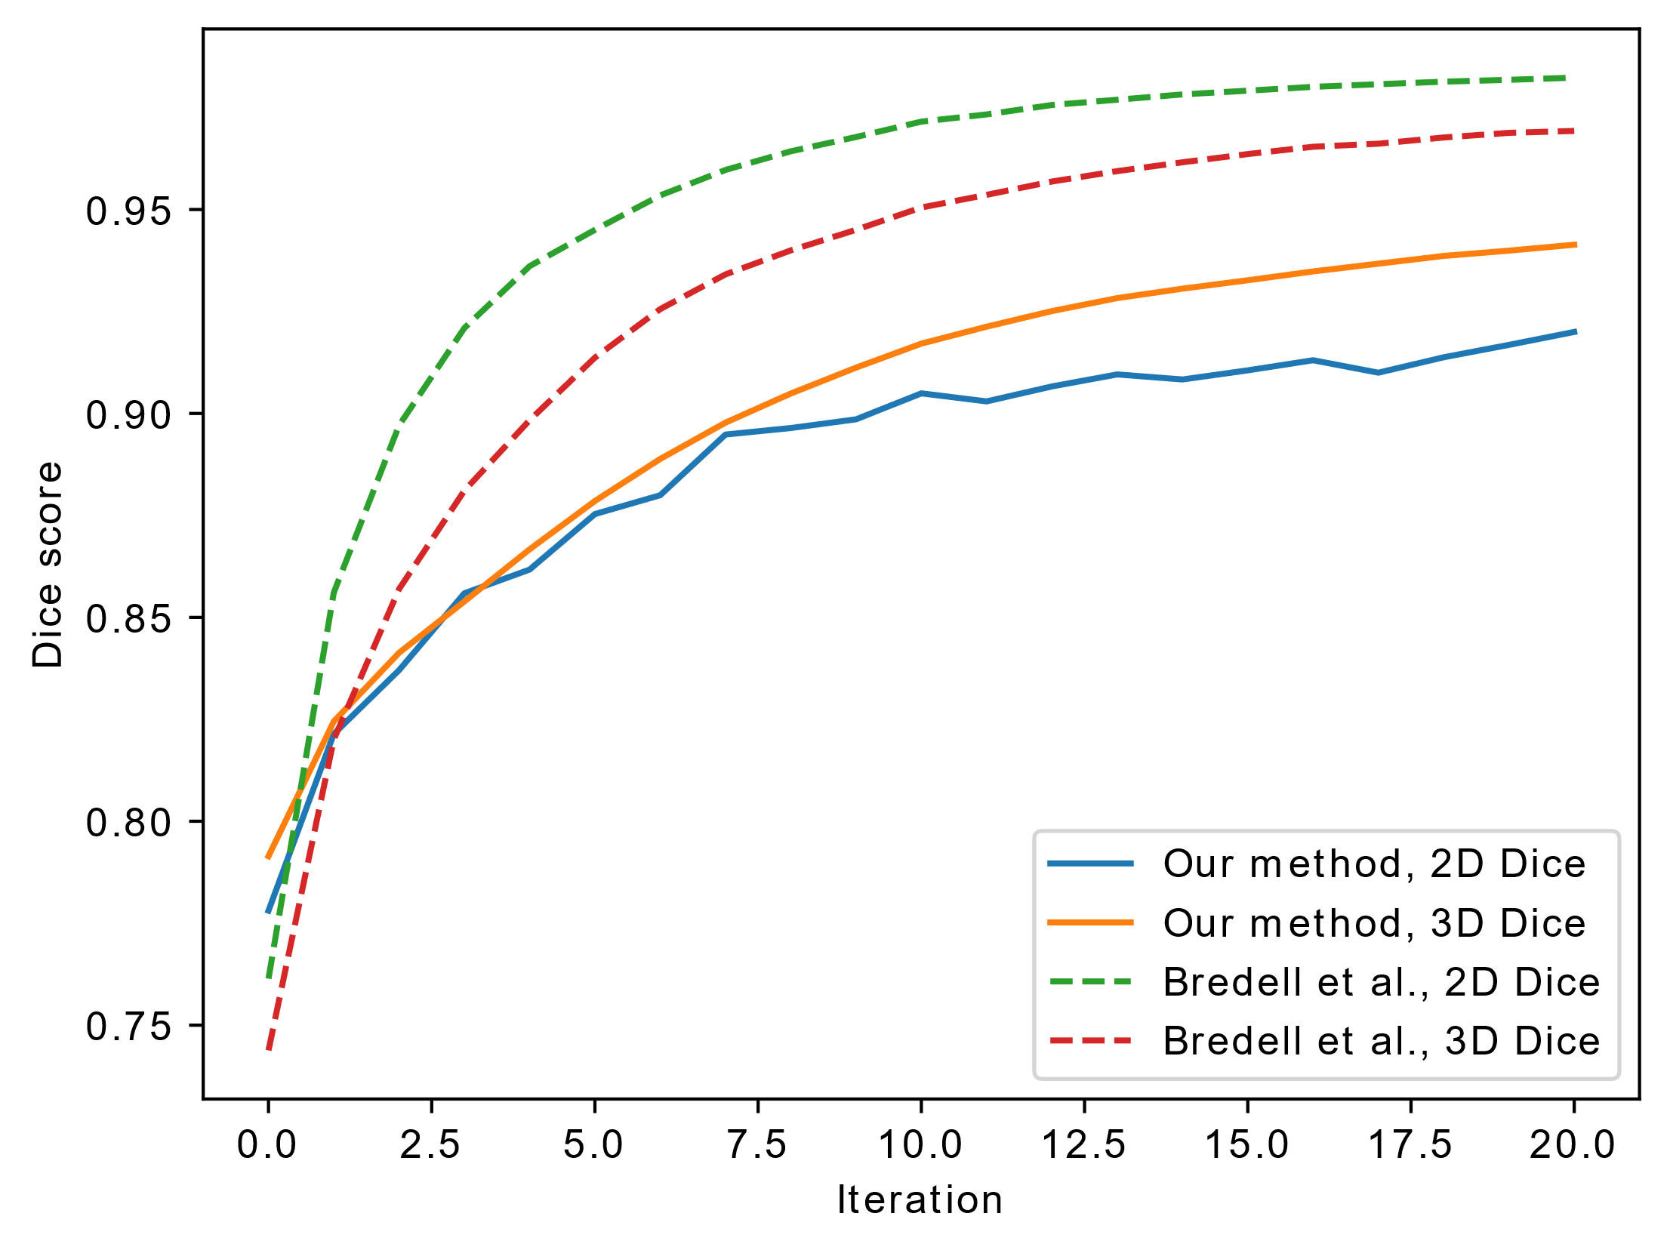
InterCNN with 2D Scribbles
Our 3D AutoCNN model is more accurate.
The 2D interCNN model by Bredell et al. improves quicker.
Our method: 94.14% peak accuracy.
Bredell et al.: 96.93% peak accuracy.

Slide 12
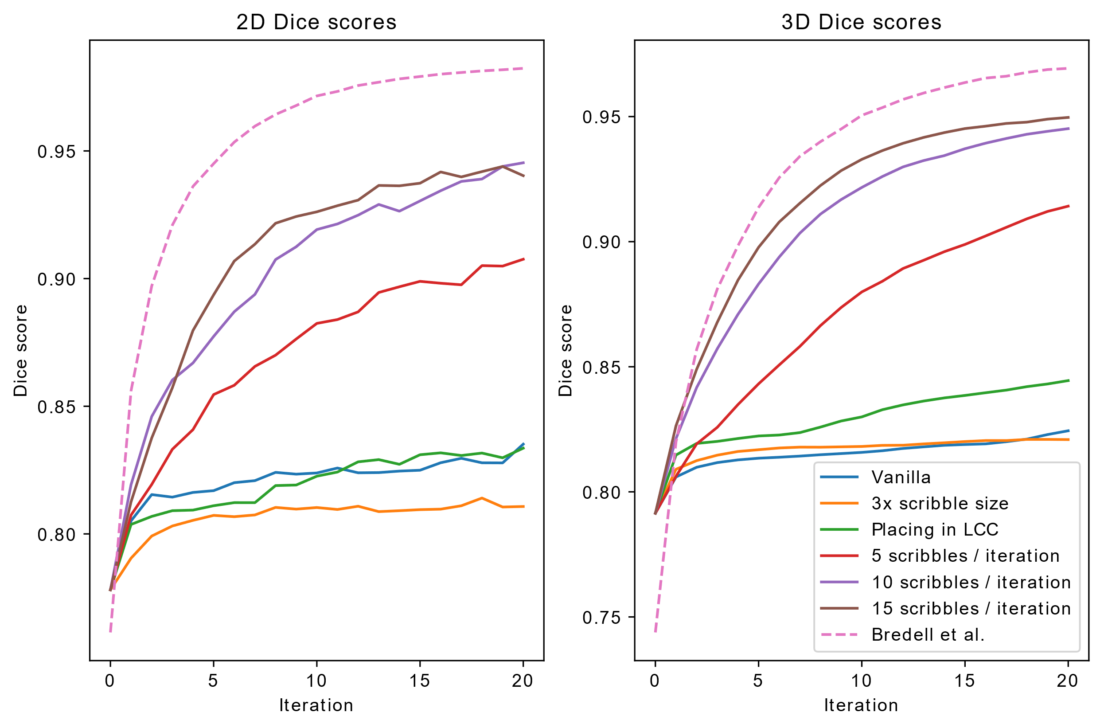
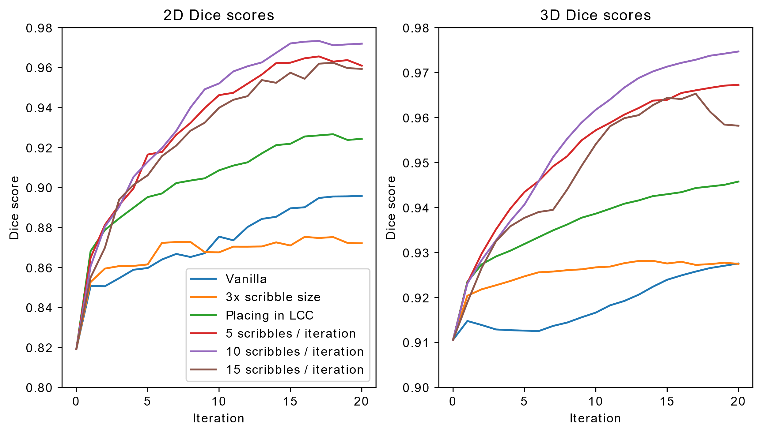
3D Scribble Results
Binary Segmentation
Multiclass Segmentation

Slide 13
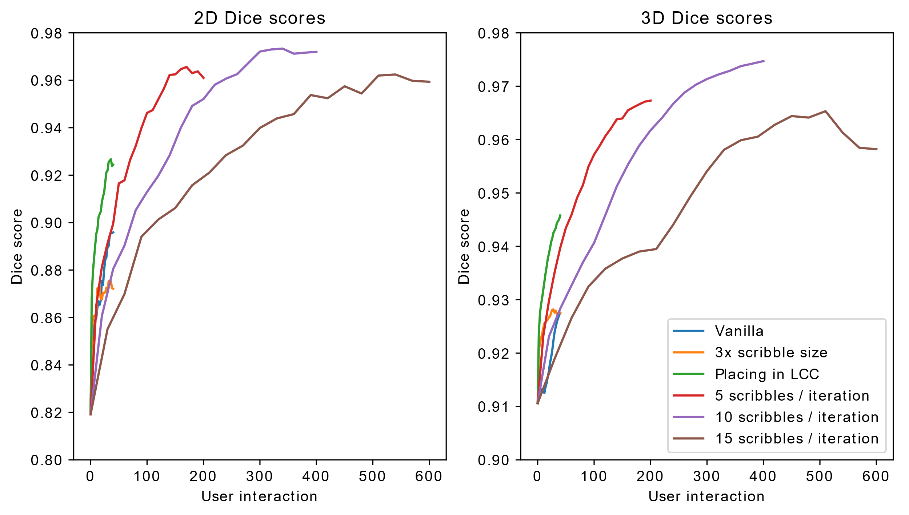
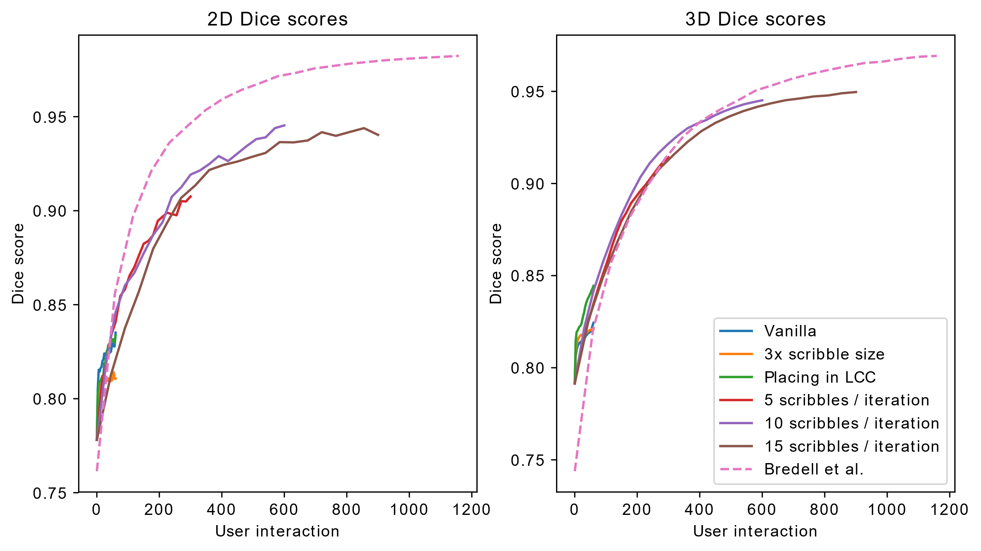
3D Scribble Results
Binary Segmentation
Multiclass Segmentation

Slide 14
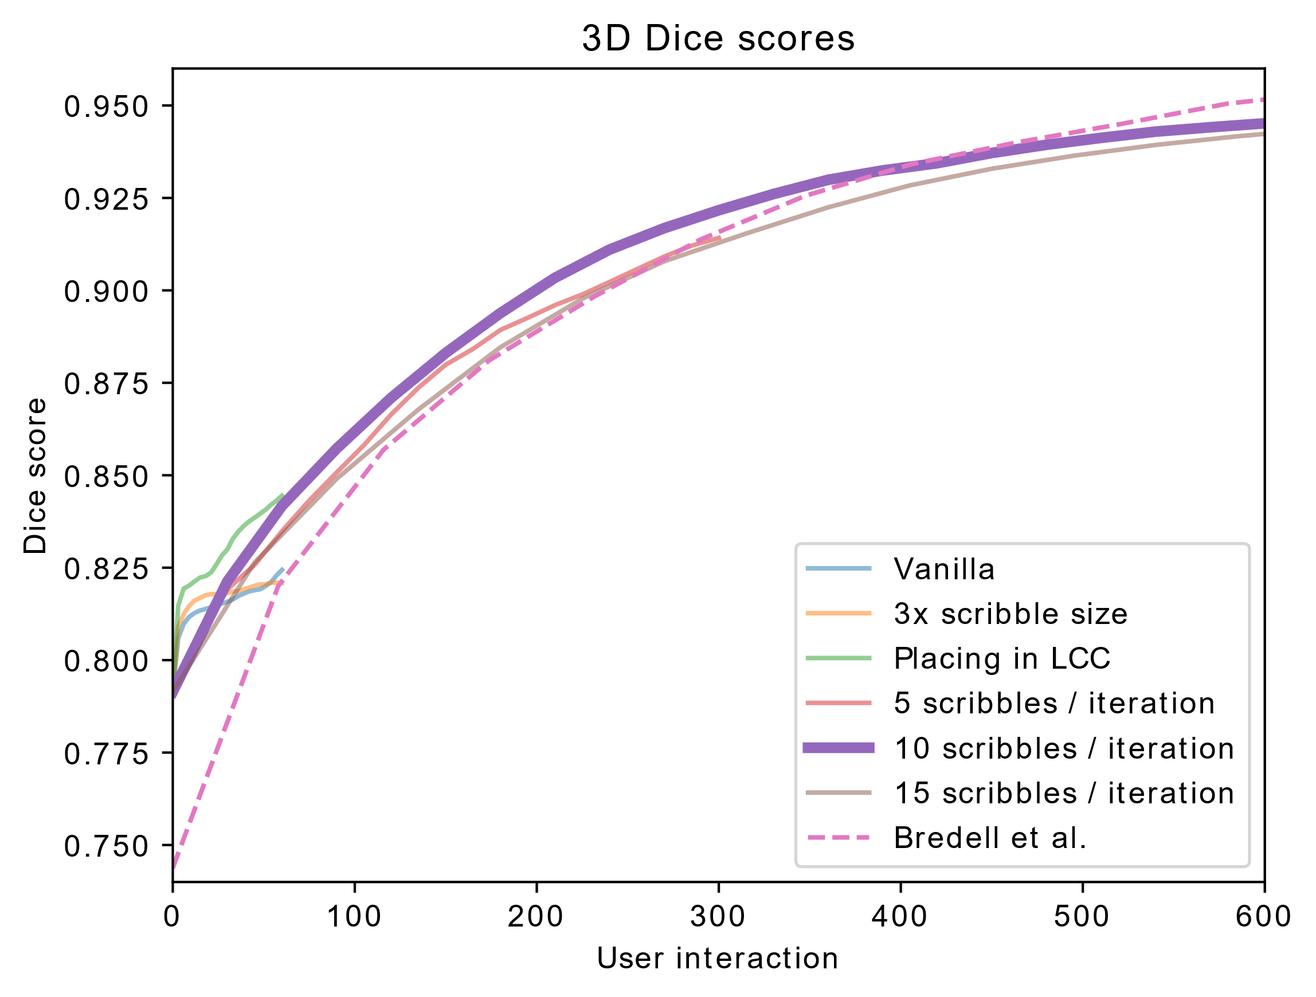
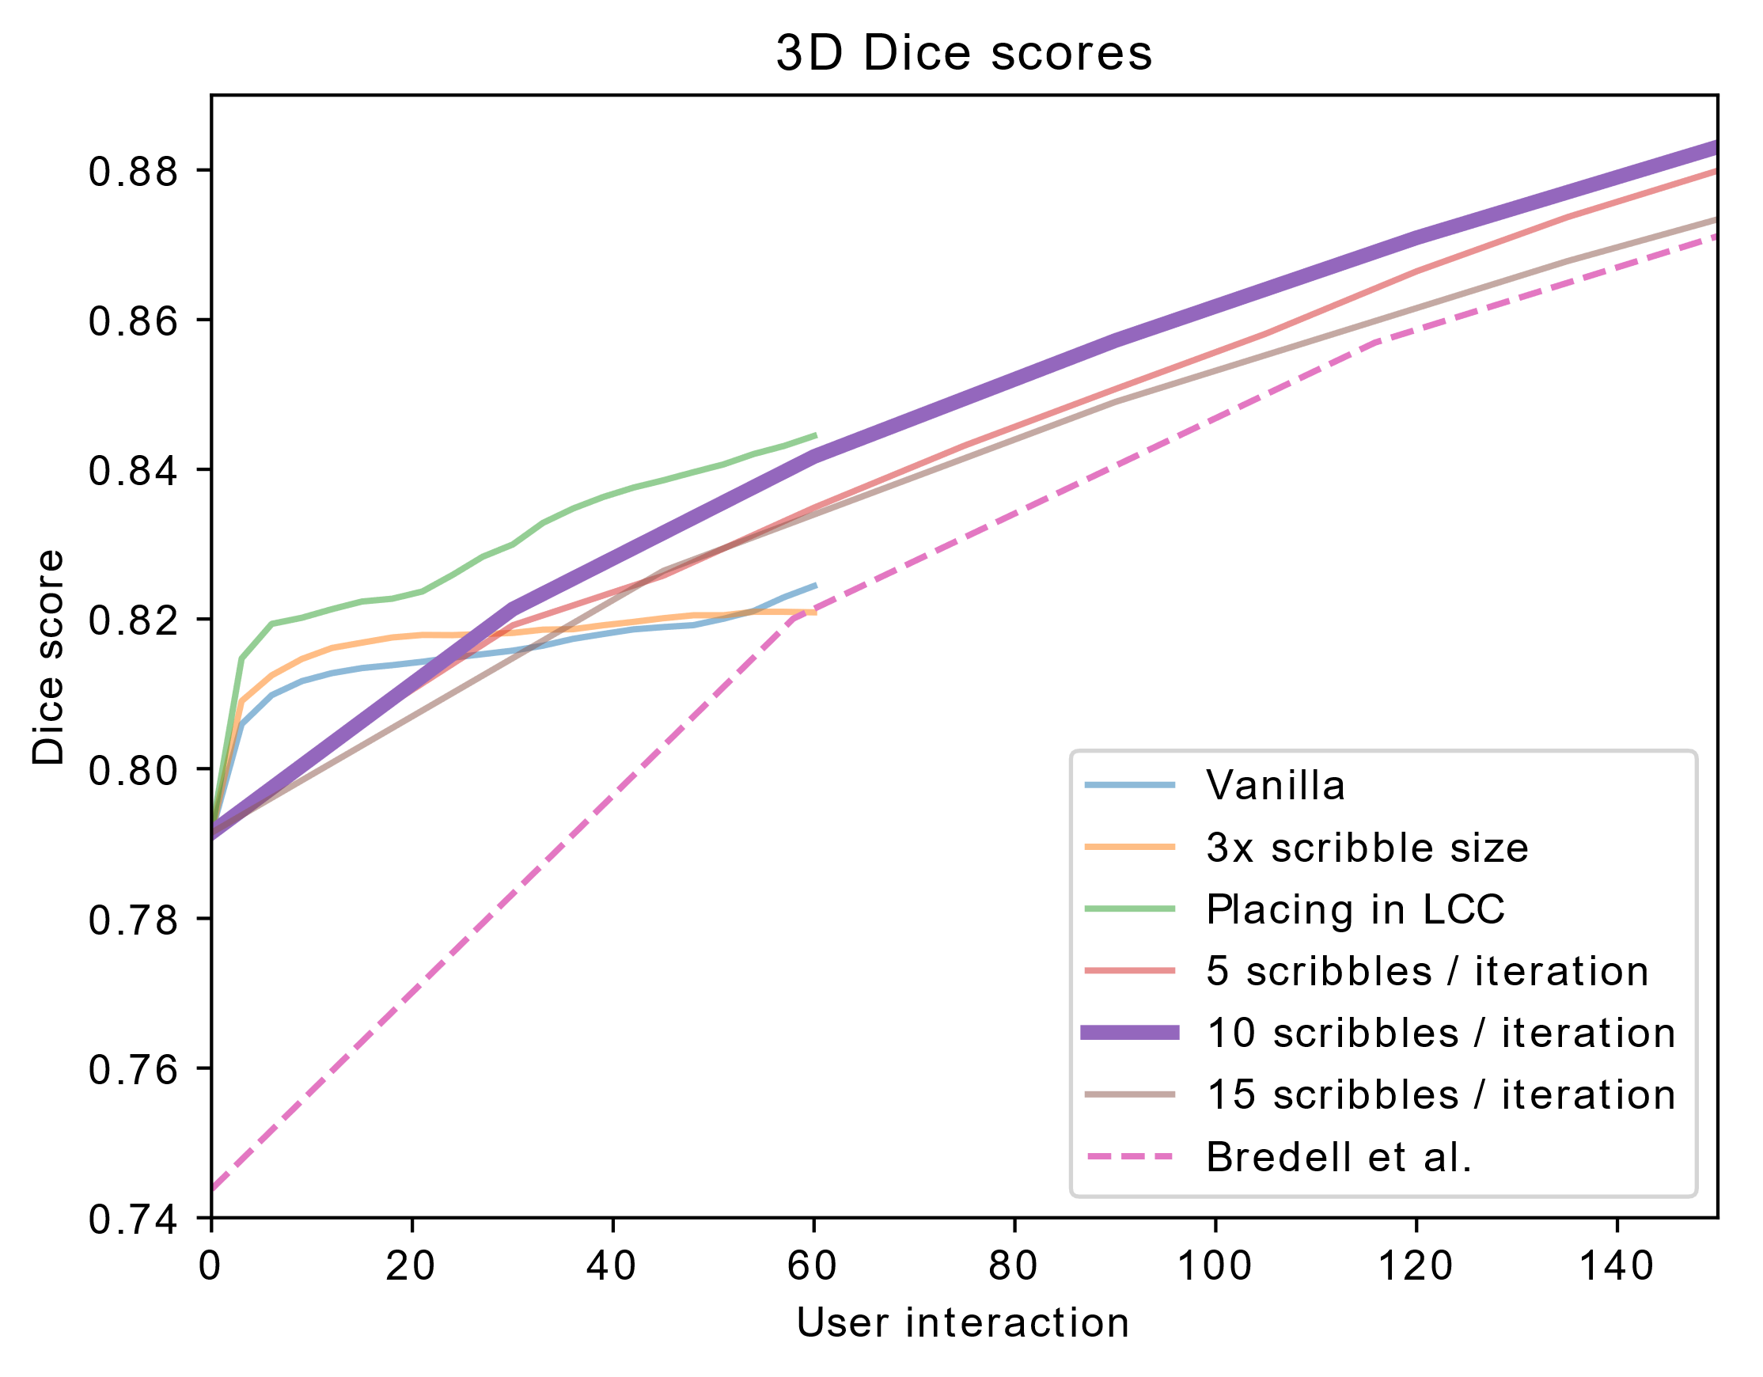
Multiclass 3D Scribble Results

Slide 15
Discussion
Our 3D scribble results are promising.
More accurate multiclass results with less user interaction.
Future work:
Fix GPU memory issues.
Train the framework on other datasets (e.g. BraTS)
Combine the two architectures (3D AutoCNN + 2D interCNN).
Explore other types of scribbles
Notes:
Our AutoCNN model reached 91% for the binary segmentation and 79% for the multiclass segmentation.
Our 2D InterCNN results reached 94% after 20 iterations.
Our 3D InterCNN results with 10 scribbles / iteration reached 97.5% and 95%
There are other types of user input that might improve the accuracy of our InterCNN over each iteration, e.g. allowing the user to draw lines or shapes.

Slide 16
Summary
Ground-truth autoCNN interCNN, 1 iter interCNN, 5 iter
Motivation:
Combine 3D and semi-automatic segmentation.
Methods:
Framework.
Scribbles.
Results:
Accurate segmentation w/ less user input.

Slide 17
Bibliography
[1] W. Burton, “2D or 3D? A Simple Comparison of Convolutional Neural Networks for Automatic Segmentation of Cardiac Imaging” https://towardsdatascience.com/2d-or-3d-a-simple-comparison-of-convolutional-neural-networks-for-automatic-segmentation-of-625308f52aa7.
[2] G. Wang et al., “Interactive Medical Image Segmentation Using Deep Learning With Image-Specific Fine Tuning,” in IEEE Transactions on Medical Imaging, vol. 37, no. 7, pp. 1562-1573, July 2018. doi: 10.1109/TMI.2018.2791721.
[3] M. Amrehn et al., “UI-Net: Interactive Artificial Neural Networks for Iterative Image Segmentation Based on a User Model,” CoRR, vol. abs/1709.03450, 2017.
[4] G. Bredell et al., “Iterative Interaction Training and Memory Effects on Segmentation Editing,” Master’s Thesis, ETH Zürich, October 2018. [5] Ö. Çiçek et al., “3D U-Net: Learning Dense Volumetric Segmentation from Sparse Annotation,” in Medical Image Computing and Computer-Assisted Intervention – MICCAI 2016 (S. Ourselin, L. Joskowicz, M. R. Sabuncu, G. Unal, and W. Wells, eds.), (Cham), pp. 424–432, Springer International Publishing, October 2016.

Slide 18
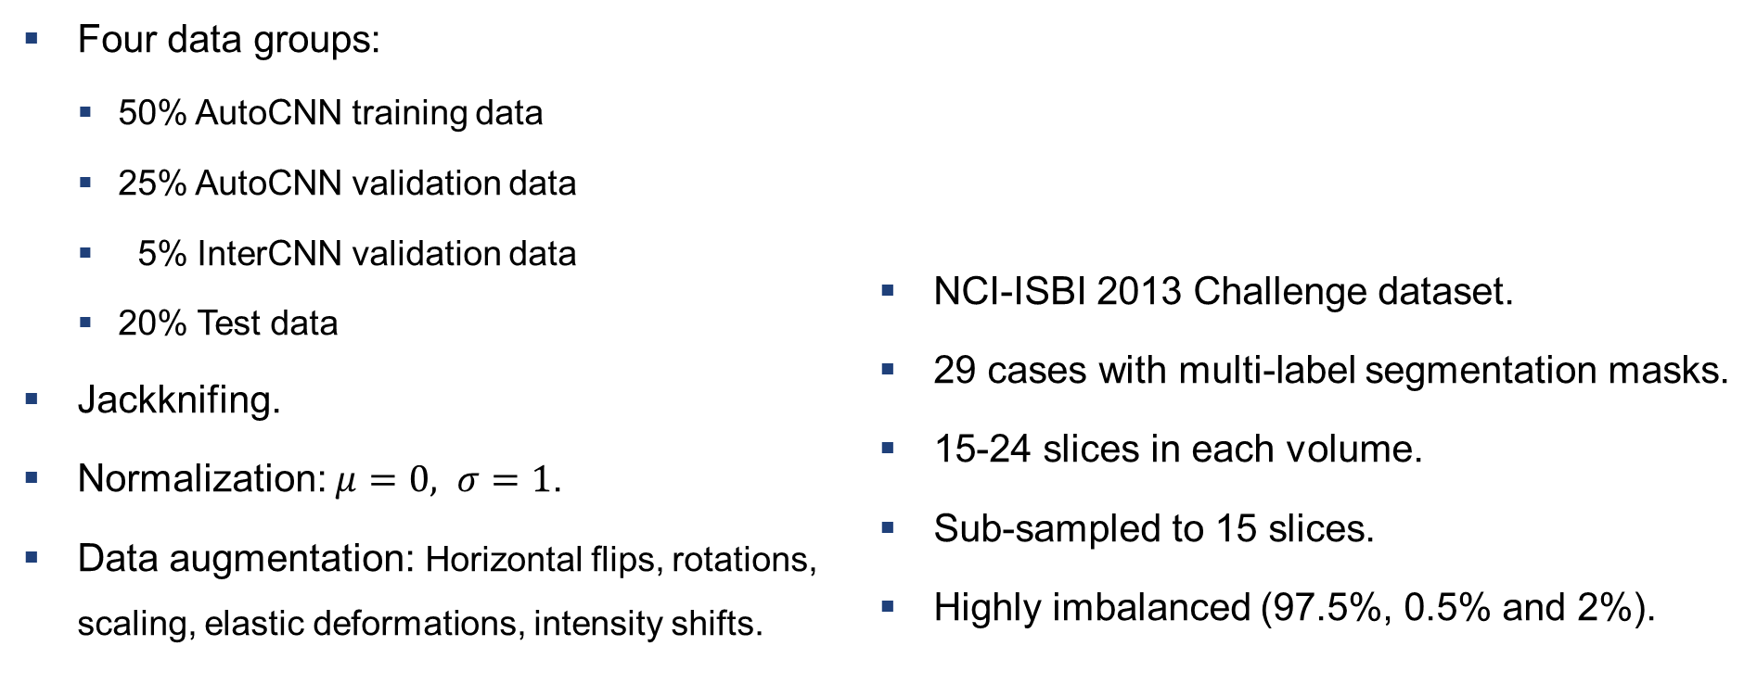
Materials and Methods: Training Procedure
Four data groups:
50% AutoCNN training data
25% AutoCNN validation data
5% InterCNN validation data
20% Test data
Jackknifing.
Normalization: $μ=0, σ=1$.
Data augmentation: Horizontal flips, rotations, scaling, elastic deformations, intensity shifts.
NCI-ISBI 2013 Challenge dataset.
29 cases with multi-label segmentation masks.
15-24 slices in each volume.
Sub-sampled to 15 slices.
Highly imbalanced (97.5%, 0.5% and 2%).
InterCNN training data

Slide 19
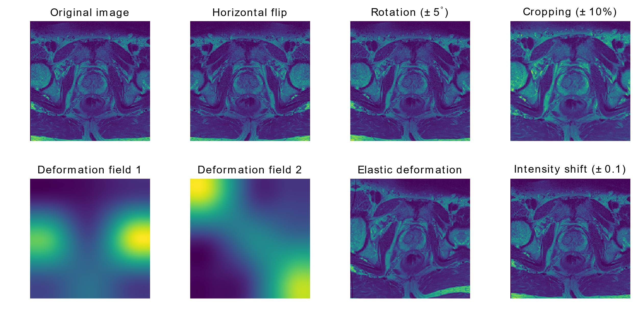
Materials and Methods: Data Augmentation
Notes:
Two 3x3 deformation fields are created by randomly sampling from a normal distribution with stdev=10. Expanded to the height&width of the volume using bicubic interpolation. Applied to the image.

Slide 20
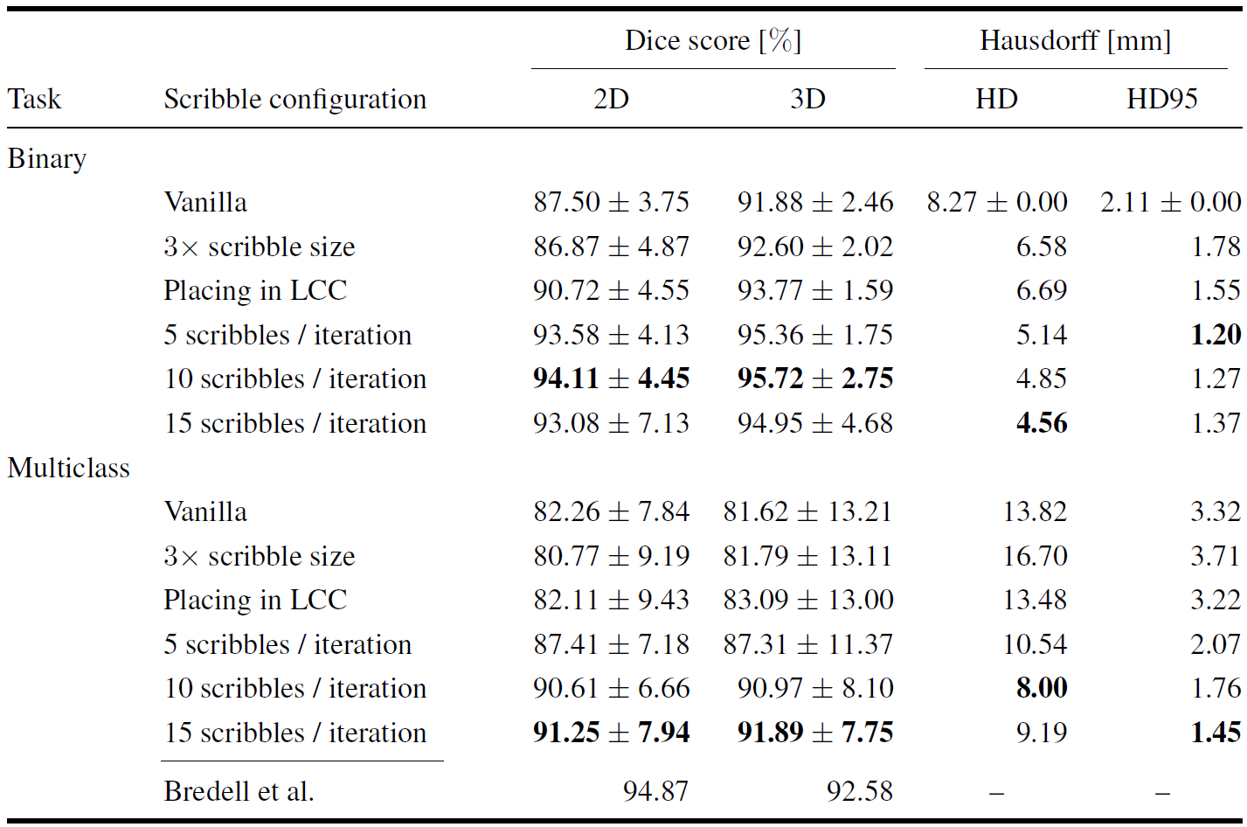
InterCNN with 3D Scribbles
Notes:
High standard deviations: The scores are the average over 20 iterations.

Slide 21
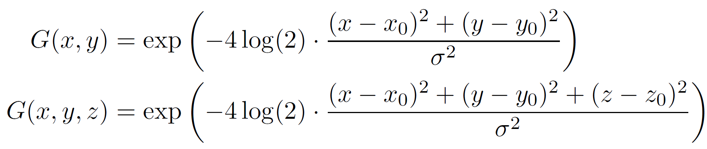
Materials and Methods: Scribble Generation
A robot-user inspects the ground-truth and the model’s prediction, finds the incorrectly labeled pixels and clicks on a random one.
Each click is converted to a scribble using a 2D or 3D Gaussian function:
One round of the robot-user creating scribbles for each class label = iteration.
Notes:
(x,y,z) = (height, width, depth)
(x0,y0,z0) = location of the clicked pixel.
$σ$ controls the width of the Gaussian.

Slide 22
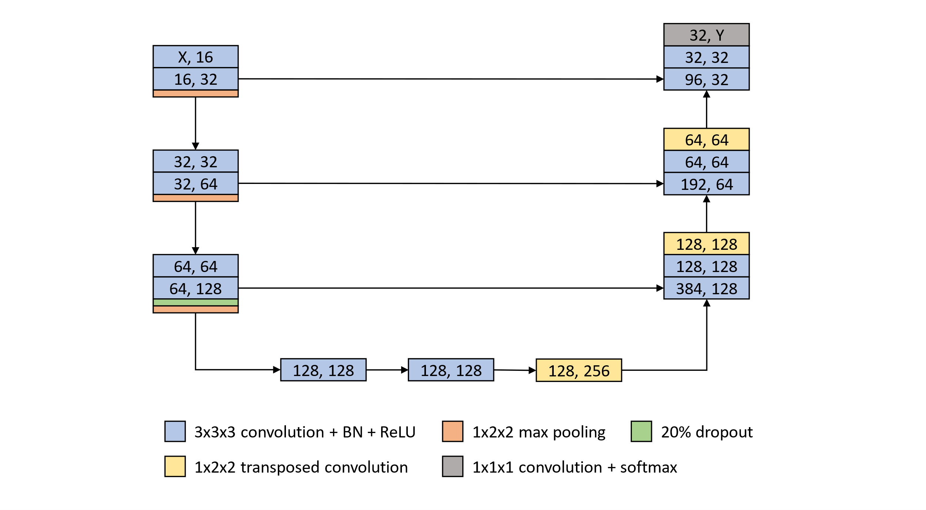
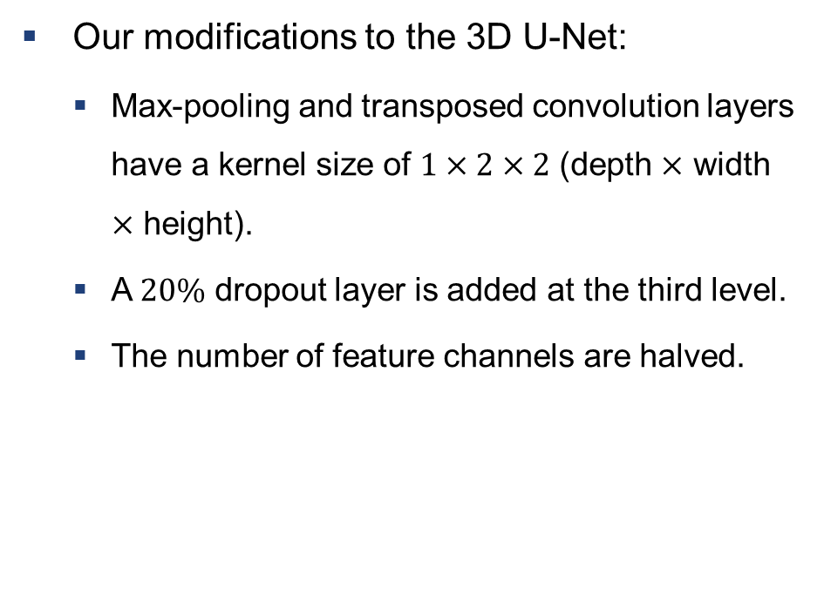
Materials and Methods: Model Architectures
Our modifications to the 3D U-Net:
Max-pooling and transposed convolution layers have a kernel size of $1×2×2$ (depth $×$ width $×$ height).
A $20\%$ dropout layer is added at the third level.
The number of feature channels are halved.
Notes:
The sub-sampled volumes have only 15 slices => would end as a single-slice volume (2D img) at the lowest layer.
Reduce the likelihood of overfitting the data.
Ensure that a sub-sampled volume with full height/width fits into the model (GPU memory)!

Slide 23
Experiments and Results
AutoCNN trained for 500 epochs.
InterCNN trained for 50 epochs with 10 training iterations.
Tested with 20 iterations.
Notes:
AutoCNN results are included in the InterCNN results. Let’s start.

Slide 24
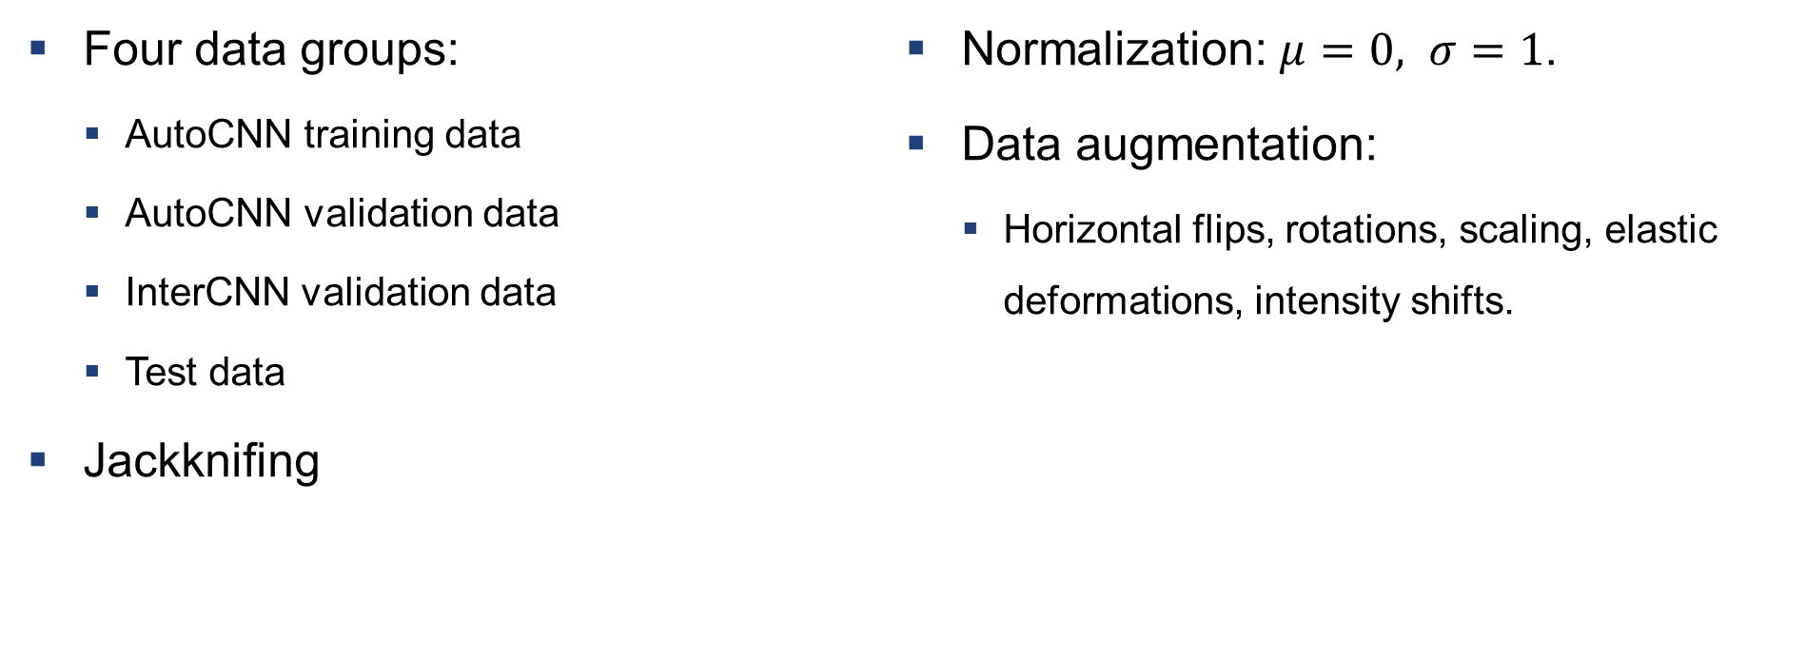
Materials and Methods: Training Procedure
Four data groups:
AutoCNN training data
AutoCNN validation data
InterCNN validation data
Test data
Jackknifing
Normalization: $μ=0, σ=1$.
Data augmentation:
Horizontal flips, rotations, scaling, elastic deformations, intensity shifts.
InterCNN training data
Notes:
50% = AutoCNN training, 25% = AutoCNN validation
(improve the AutoCNN robustness, feed more unseen data do InterCNN).
The subjects are randomly sampled 3-5 times to create different data splits. Models trained independently and scores averaged.

Slide 25
Materials and Methods: Dataset
NCI-ISBI 2013 Challenge dataset.
29 patient cases with multi-label segmentation masks.
15-24 slices in each volume.
Sub-sampled to 15 slices.
Highly imbalanced.
Notes:
T2-weighted MRIs. Of the 60 patient cases, only 29 have multi-label segmentation masks consisting of three different labels (0, 1, 2).
To ensure a consistent input size, the volumes are sub-sampled to 15x320x320.

Slide 26
Binary 3D Scribble Results

Slide 27
Binary 3D Scribble Results

Slide 28
Multiclass 3D Scribble Results

Slide 29
Multiclass 3D Scribble Results

Slide 30
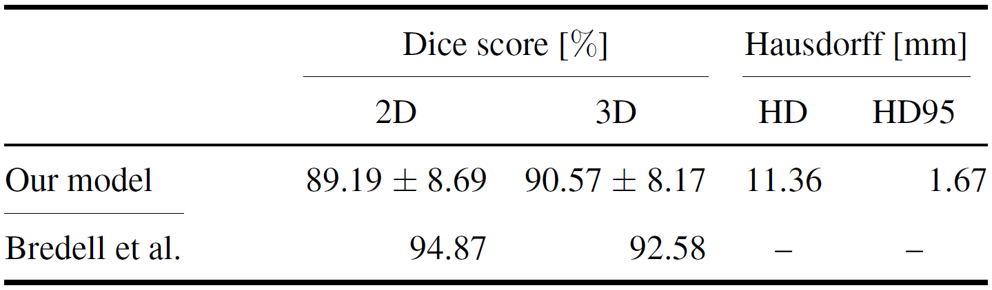
InterCNN with 2D Scribbles
Our 3D AutoCNN model is more accurate.
The 2D interCNN model by Bredell et al. improves quicker.
Our method: 94.14% peak accuracy.
Bredell et al.: 96.93% peak accuracy.

Slide 31
Conclusion
We have developed a framework for segmenting medical images in 3D, first automatically and then iteratively via scribbles generated by a robot-user.
Our automatic segmentation model achieved a 79% accuracy.
Our semi-automatic segmentation model was more accurate than our predecessor for fewer user interactions.

Slide 32
Introduction
Image segmentation is an ever-growing field in medical image analysis.
Manual segmentation.
Fully-automatic segmentation.
Semi-automatic segmentation.
Notes:
Image segmentation is one of the biggest and most challenging tasks in medical image analysis to aid human experts in detecting and diagnosing diseases in the human body.
Developing precise and reliable algorithms is critical.
Advancements in machine learning and computer vision have further increased these algorithms' accuracy and dependability.
Bredell et al.: developed the framework for 2D segmentation. Our goal is to expand the model and scribbles to 3D.

